Slide 1
BLOB-FREE
System requirement review (SRR)
Interdisciplinary project A.Y. 2020/21
Proposed by pROf. dovis, prof. piras and prof. di pietra

Slide 2

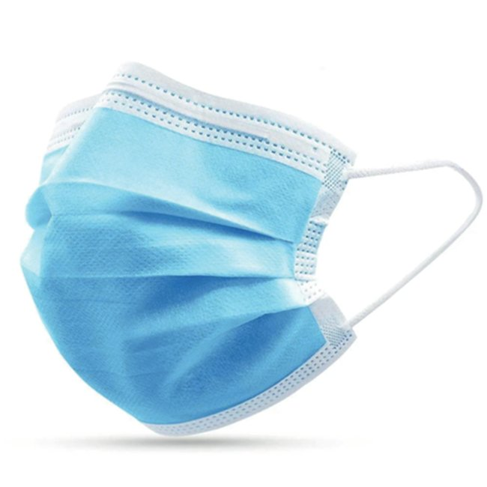
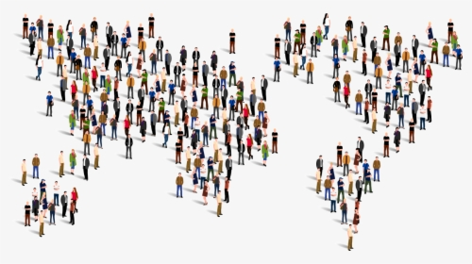
BLOB-FREE
Computer vision system for reducing Coronavirus infection risk
MASK detection
ASSEMBLAGE detection

Slide 3




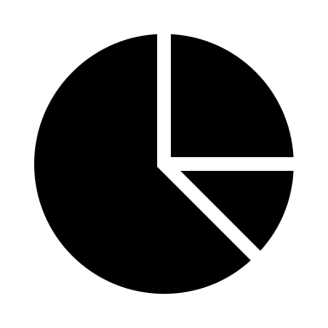
USER REQUIREMENTS
Facilitate surveillance where the infection risk could be high (e.g. corridors of a university)
Automate warnings for rules violation
Hardware + Software + Web interface

Slide 4
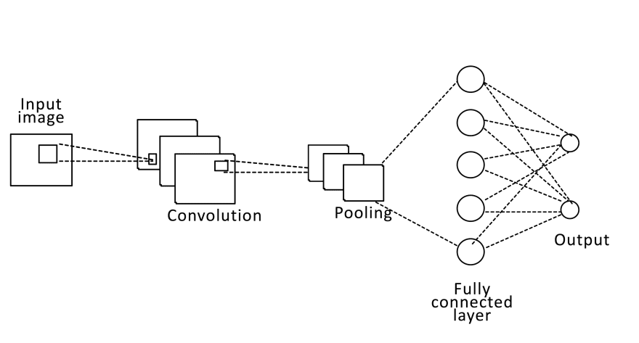
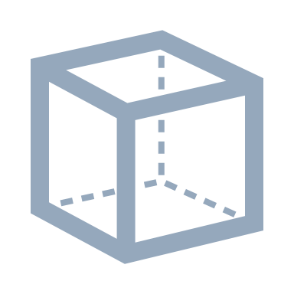

Technical Requirements
Face detection and localization in 3D space
Convolutional neural network (CNN)
3D distance between heads’ centroids

Slide 5
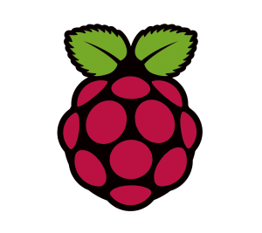
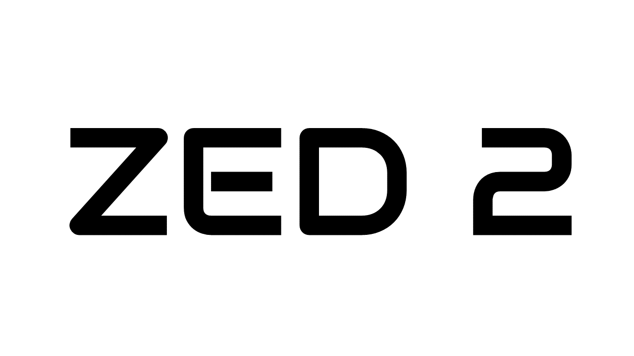


Hardware
Raspberry Pi and Pi Camera
Pros: cheap, small, low power consumption
Cons: low computational power, lower reliability
ZED2 Stereo Camera and NVIDIA Jetson Nano
Pros: high computational power, reliability
Cons: expensive, bulkier, higher power consumption

Slide 6
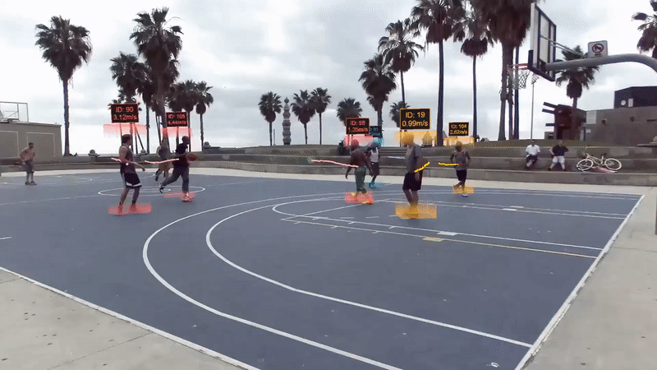
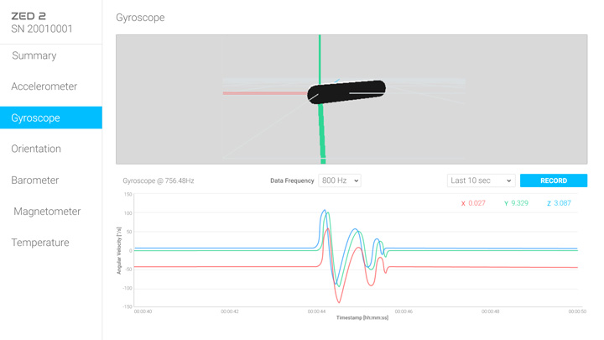
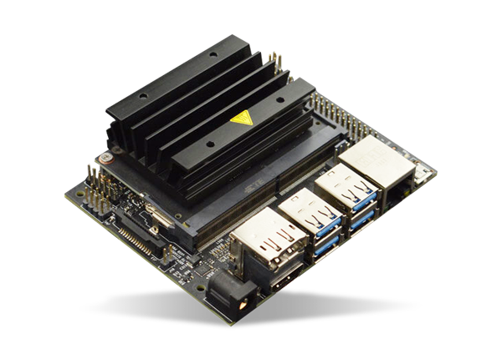
Stereolabs ZED2
DEPTH
ZED2 Stereo Camera
Depth mapping
Object tracking
Inertial measurement unit (IMU)
Neural networks-based SDK exploiting CUDA acceleration (NVIDIA GPU required)
NVIDIA Jetson Nano
Development board with NVIDIA GPU
B
G
R

Slide 7



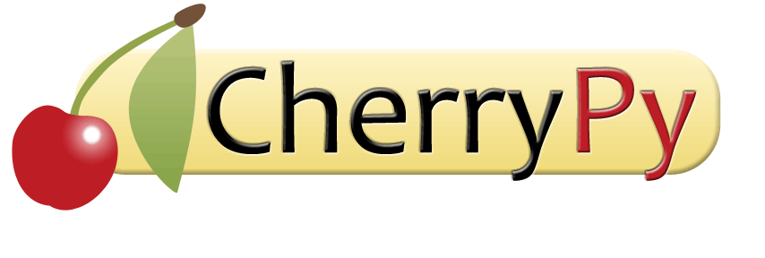

Software
Python
Computer vision:
Open CV
Tensorflow
Numpy
ZED SDK
Management system:
CherryPy
MongoDB

Slide 8
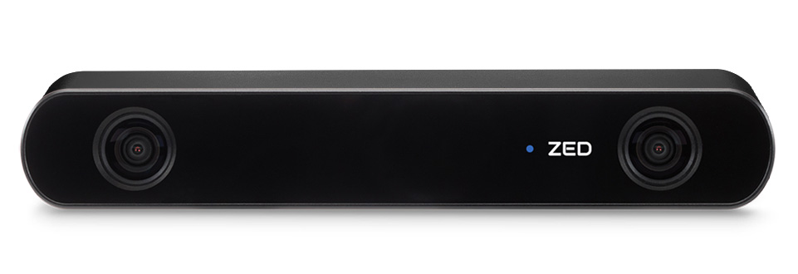
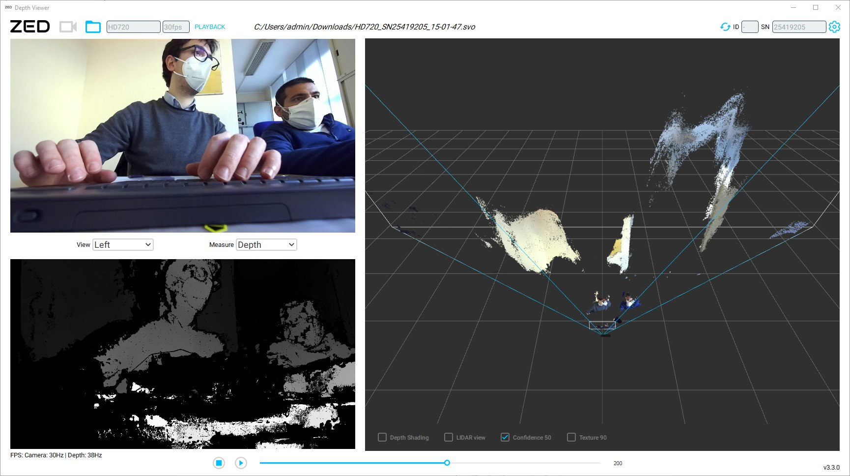
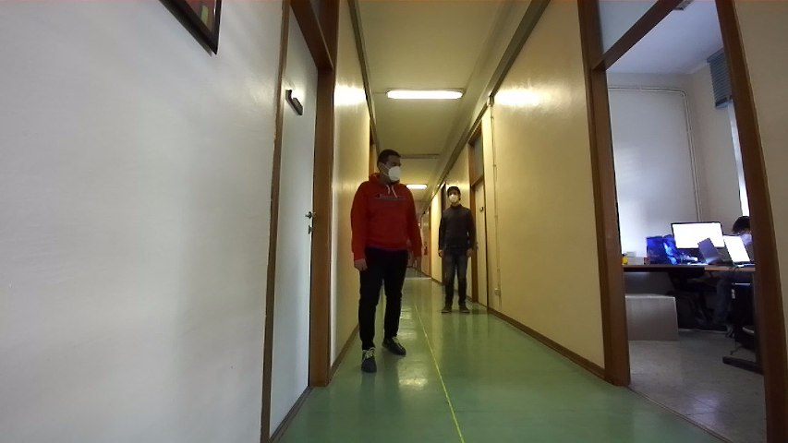
Camera Testing
ZED2 Camera arrived at Politecnico
Camera test in different conditions and accuracy evaluation
Preliminary test of the SDK
Nov. 11, 2020
Nov. 18, 2020
Nov. 25, 2020
Good accuracy (+/- 10 cm) for short distances (1-6 m)
Depth sensing working up to 15 m

Slide 9
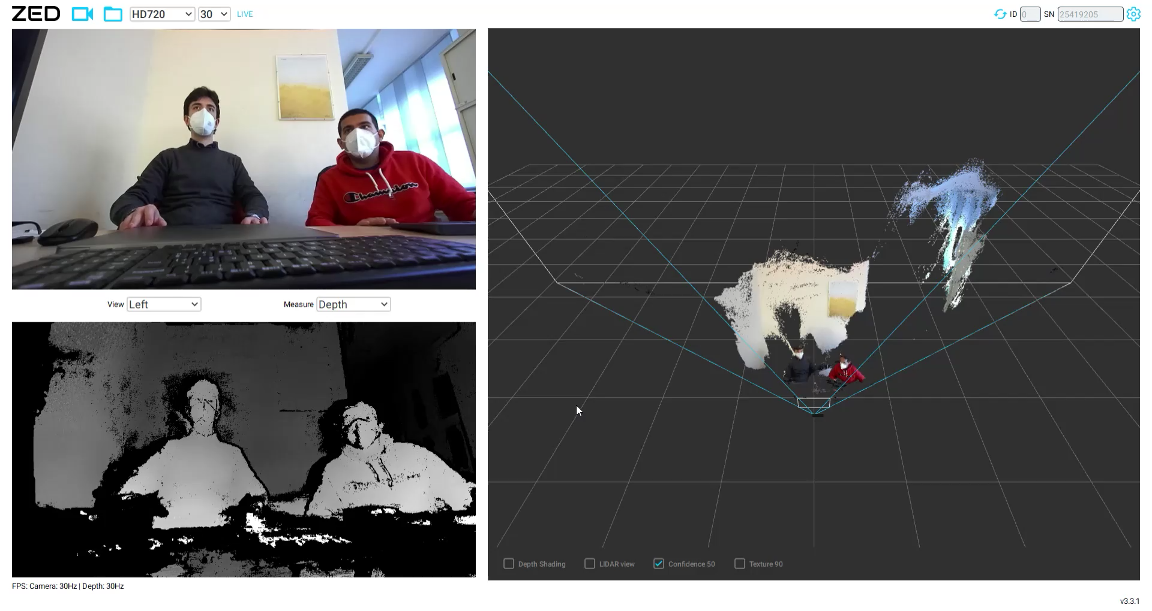
DEPTH MAP

Slide 10
Workplan
27/11
SRR
18/12
PDR
15/1
CDR
7/5
TRR
25/6
FR
16/10 – 30/10

Slide 11
Thank you for the attention!
Team members:
Can Akgol (s274948)
Paolo De Santis (s280398)

